Slide 1
Team Day Learning

Slide 2
Show Game

Slide 3
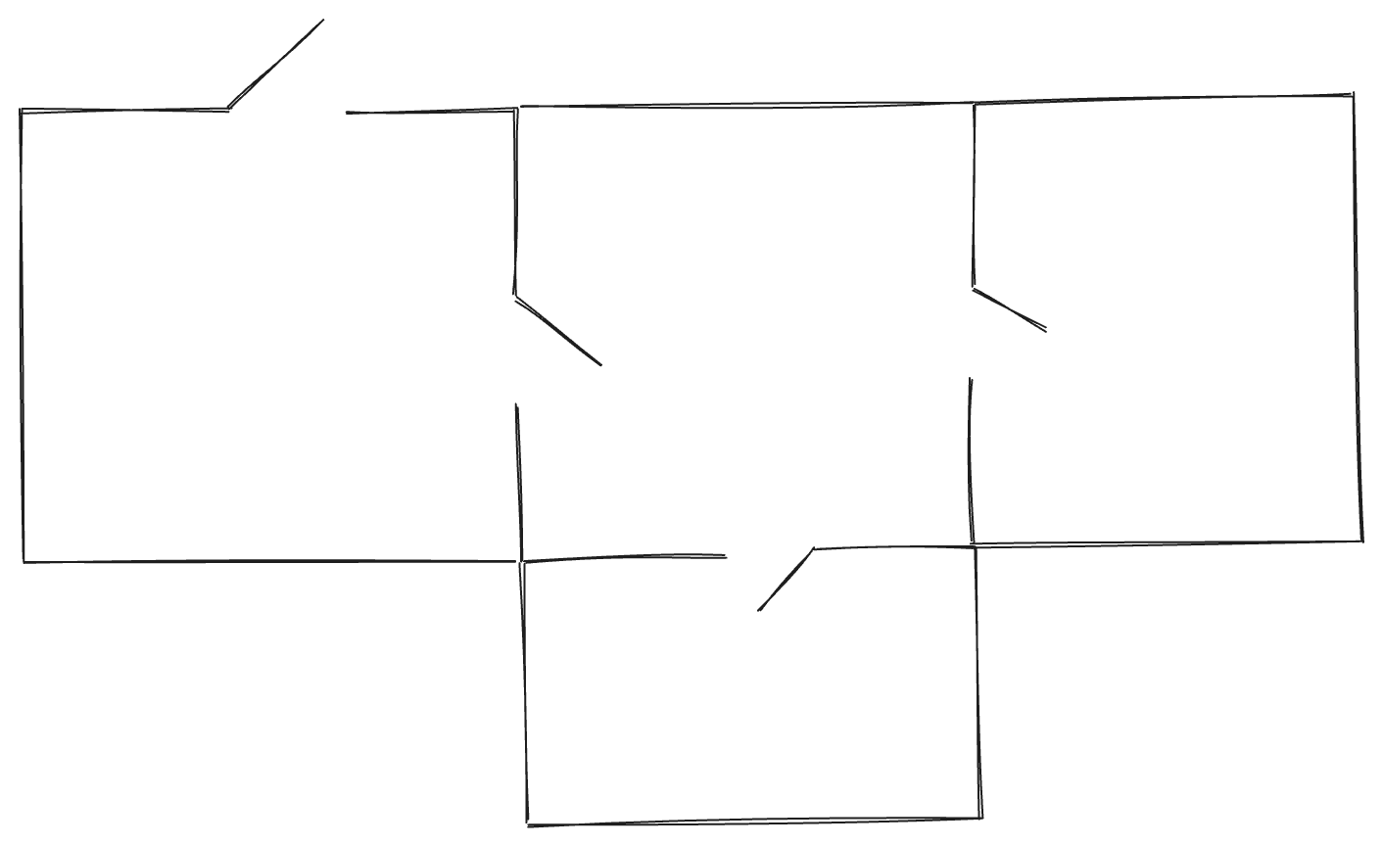
Dungeon

Slide 4
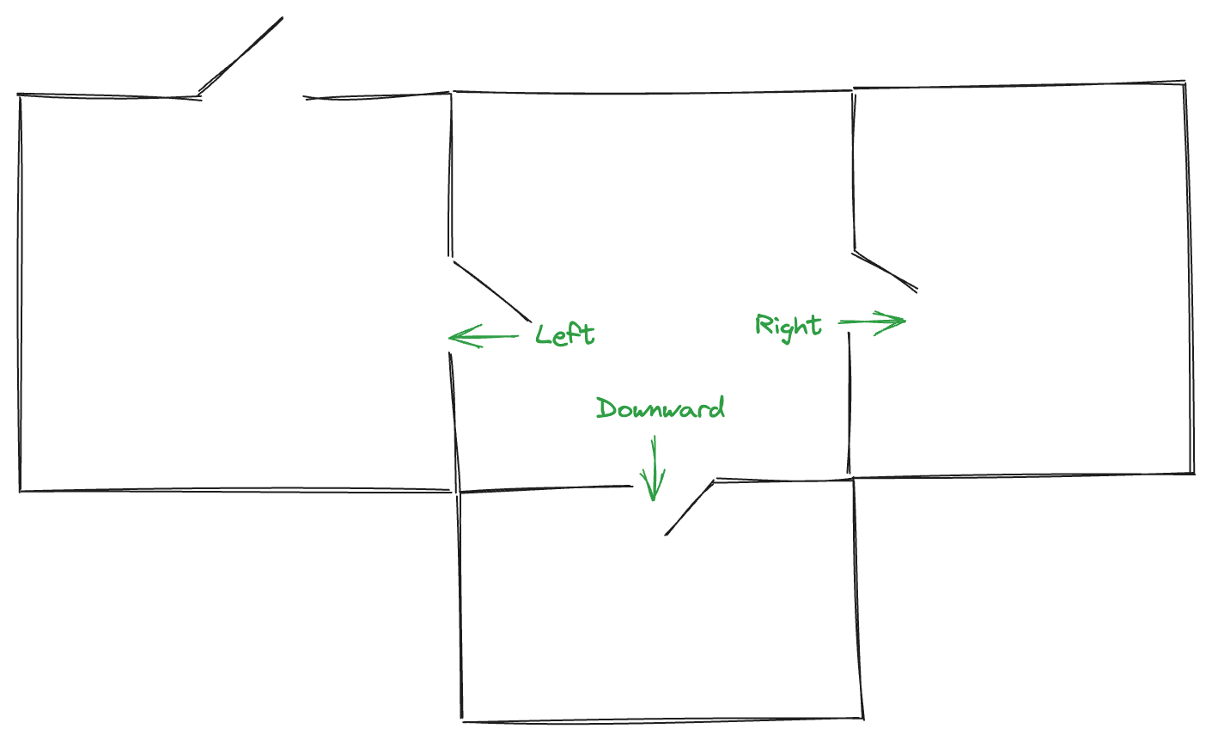
Dungeon

Slide 5
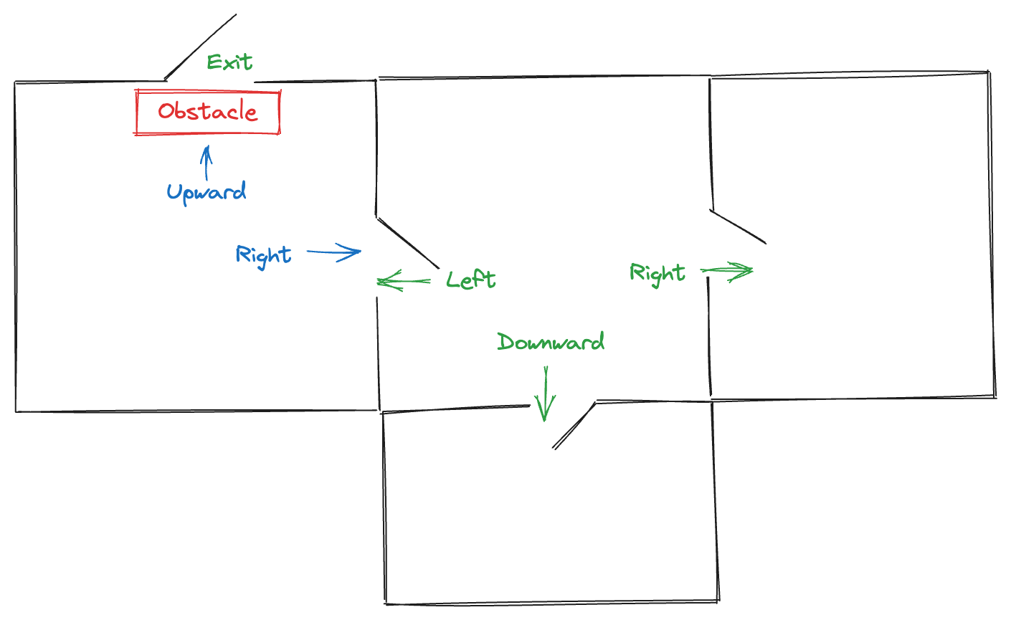
Dungeon

Slide 6
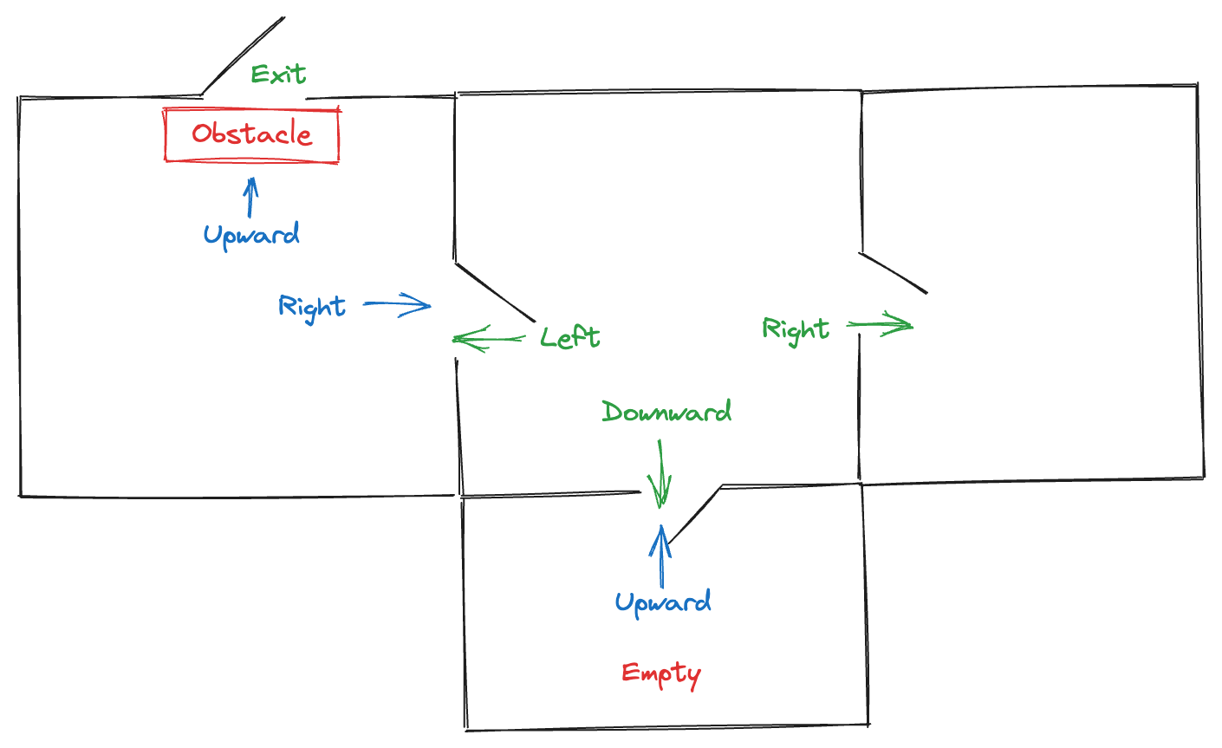
Dungeon

Slide 7
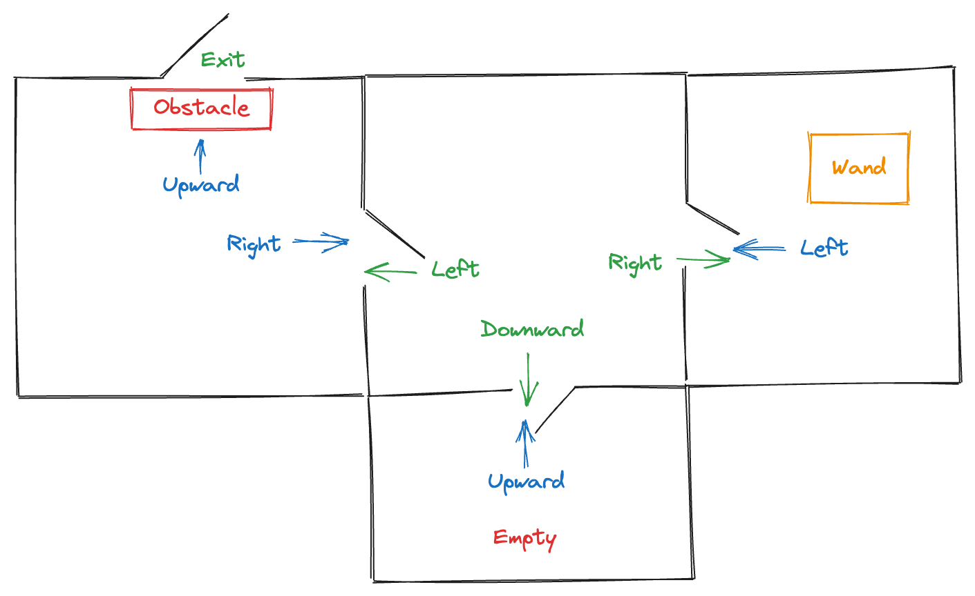
Dungeon

Slide 8
What is programing language
Regardless of language every novel follows similar pattern. It consists of chapters, paragraphs, sentences, words and letters. Programming languages are somewhat similar. They all try to create a set of instruction that computer will need to follow. Some are more human readable, some are more capable.
Instructions to computers

Slide 9
Using logic to tell computer Instructions
If raining today take uber else walk

Slide 10
What concepts we will use
Variables
Lists
Functions
While loops
If conditional statement
Notes:
Like languages has grammar rules, programing languages have rules and concepts as well.

Slide 11
Why Python?
Easy for beginners to understand
Simple to run

